Slide 1
PAYMENT VIA MOBILE PHONES
By:
Akash Mantry
Rajvardhan Deshmukh
Shamanth Kumar P

Slide 2
Outline
Motivation
Background
Security Problem
Security Method
Proposed Project Algorithm
Implementation Details
Project Application Demo
Testing
References

Slide 3
Motivation
Throughout history human beings have relied on some sort of payment system to purchase the goods or services we wanted or needed. Mobile devices have changed business and now possibly the way financial transactions of all kinds are made. Consumers are willing to utilize mobile phones for payment purposes as it provides an efficient and easier way to process financial transactions.
Even though widely used, many security concerns are also involved with payment through mobile phones. One of the biggest threats can be the interception of the traffic when the mobile payment is in process. This can lead to identity theft, identification disclosure and replay attacks. Poor data protection controls also lead to data disclosure and privacy infringement. If mobile payment is not done securely then any intruder can obtain the credit card details of the user and use it to transfer illegal funds.

Slide 4
Background
Payment through mobile phones has become one of the major methods of financial transaction used all around the world. With the advent of technology there has also been numerous risks and threats have also increased which hamper the way mobile payment takes place. There is urgent need for the security issue of mobile payment to be addressed.
We are using a method widely known as the Secure Electronic Transaction to solve the security issues of mobile payment. The main purpose of the project it to solve issues like interception of payment info of the user and using such information for malicious purposes. SET achieves this by using the concept of Dual Signature. With SET, the user is given a digital certificate and a transaction is conducted and verified using a combination of digital signature and digital certificates among the user, the merchant and the user’s bank.

Slide 5
Security Problem in Payment Via Mobile Phones
Interception of Traffic
Identity Theft
Information Disclosure
Masquerade Attacks
Illegal transfer of funds
Replay Attacks

Slide 6
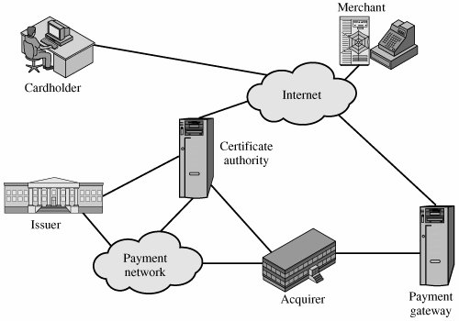
Security Method : Secure Electronic Transaction

Slide 7
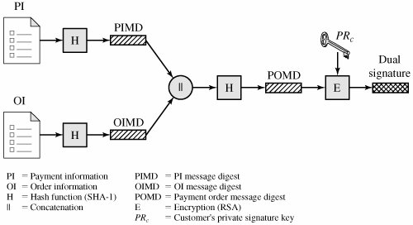
Dual Signature in SET

Slide 8
Implementation Details of the Project

Slide 9
Proposed Project Algorithm
Components:
Client –The person who orders product online.
Merchant Server – The server corresponding to the merchant.
Payment Gateway – The payment gateway for payment of the bill corresponding to the products ordered.
Certification Authority – The trusted certification authority which provides the valid Digital signature.

Slide 10
Assumptions made in the Project
Every component has the Certification Authority’s public key.
CA can be trusted.
Duplicate Session Key cannot be created.
Encrypted Timestamp cannot be altered by the attacker.
Database is combined for both merchant and bank.
Client can choose 1 product at a time.
OTP is sent to only registered phone number in Twilio.
Email notification is secure since it is handled by Gmail.
Product Name and Card Number are being sent to Merchant and Bank Server respectively.
No database is maintained for the credit card details.

Slide 11
Topics used in our Project
RSA encryption with 512 bit key
Certification Authority (X.509v1 Certificates)
Dual Signature
Session Keys
Salt
MAC(MD-5)
HMAC SHA-1 – Password
TimeStamps

Slide 12
Certificate and Key Distribution
Client
Certificate Authority
Merchant
Payment Gateway

Slide 13
Flow 1 : Certification Authority → Client, Server and Payment Gateway
CA distributes its public key to client, server and PG through one of the key exchange methods.
CA encrypts the message known by everyone with its private key and provides the digital signature.
Client, Server and PG can decrypt it using the public key of the CA which was distributed.
C, S and PG recognize CA and send their public certificates to the CA.
CA stores the digitally signed certificate for client, server and PG.

Slide 14
1) Registration of New User
Client
Merchant
E(K_{m}⁺ ,[Identifier, Username, Password, Email, Phone Number])
E(K_{c}⁺ , [Verification message and Timestamp])

Slide 15
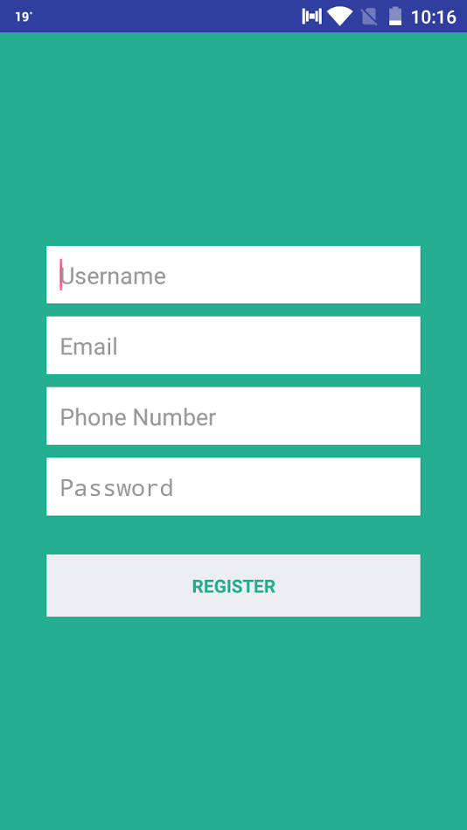
Registration of New User Page
Implementation of Registration Page:
Register new user using the fields – Username, Email, Phone Number and Password.
The registration details are sent along with the Identifier(“Registration”).
All the fields sent are encrypted with merchant’s public key hence providing security.
A table called “User” table maintains the list of the users in the database.
When a user registers and the user is found to be unique the registration process succeeds and the newly registered user details is updated in the “User” table.
The merchant sends the verification message(“Successful” or “Unsuccessful”) and the timestamp as reply. The message and the timestamp are encrypted with the public key of the client.
If the user already exists or if the time condition fails then the registration process fails.
After successful registration, the user is directed to Login Page.

Slide 16
2) User Login Page
Client
Merchant
E(K_{m}⁺ ,[Identifier, Username, Password, Email, TimeStamp Session_CtoM]).
E(K_{c}⁺ , [Verification Message, TimeStamp, Session_CtoM, Phone Number])

Slide 17
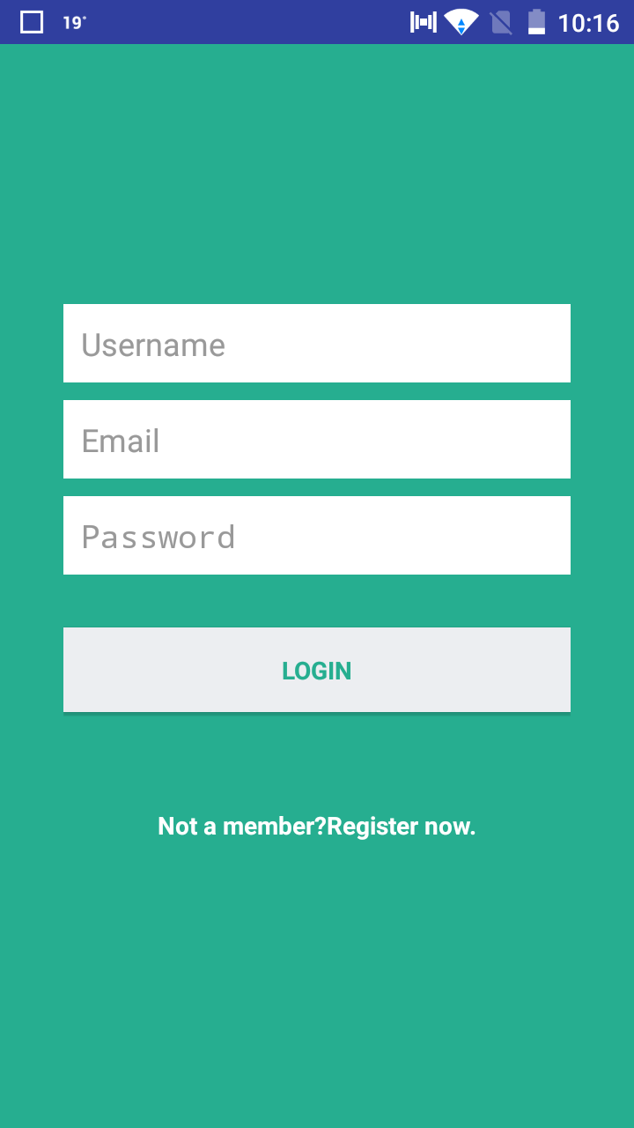
User Login Page
Implementation of Login Page:
Registered User can login on the Login page using the following fields – Username, Email and Password.
The login details are sent along with the Identifier(“Login”), TimeStamp and Session Key(Session_CtoM).
All the fields sent are encrypted with merchant’s public key hence providing security.
A table called “User” table maintains the list of the users in the database.
When a user logs in and the user’s login credentials are correct, the login process succeeds and the details are updated in the “Sessions” table.
The merchant sends the verification message(“Successful” or “Unsuccessful”), TimeStamp, Session_CtoM and phone number as reply. Everything is encrypted with the public key of the client.
After successful login the user is directed to the Products page.

Slide 18
3) Product Selection Page
Client
Merchant
E(K_{m}⁺ , [Identifier, TimeStamp Session_CtoM].
Products List, Combined Hash[Products, Session_CtoM]

Slide 19
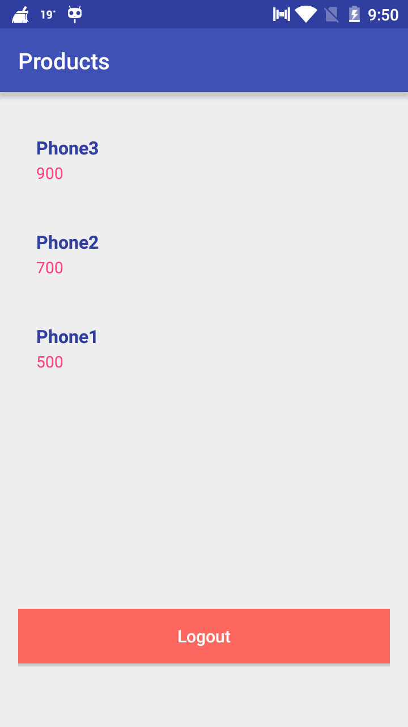
Select Product Page
Implementation of Select Products Page:
The product request is sent along with the Identifier(“Products”), TimeStamp and Session Key(Session_CtoM).
All the fields sent are encrypted with merchant’s public key hence providing security.
A table called “Products” table maintains the list of the products in the database.
When a user requests, the product list is sent along with combined hash of products and Session key.
The client verifies whether the hash is correct. If it is correct the product list is displayed.
The users selects the product available and moves to the payment page.

Slide 20
4) Client Merchant Exchange
Client
Merchant
E(K_{b}⁺ , [Card Number]), E(K_{m}⁺ , [Product], Hash[Card Number],Hash[Product], Dual Signature), E(K_{m}⁺ , [TimeStamp and Session_CtoM]).
E(K_{c}⁺ , [Verification Message, TimeStamp and Session_CtoM]

Slide 21
Flow 2 : Client → Merchant Server
Order Info is hashed.
Payment Info is hashed.
Hashed OI and Hashed PI is concatenated.
The concatenated Hashed OI and Hashed PI is hashed again.
Dual Signature for the hashed concatenated info.
Order Info is encrypted with public key of merchant and payment Info is encrypted with bank’s public key. This is sent to merchant server.
Message = (encrypted{merchant's public key} order info)+(encrypted{bank's public key} payment info)+(hash of order info)+(hash of payment info)+(concatenated hash)

Slide 22
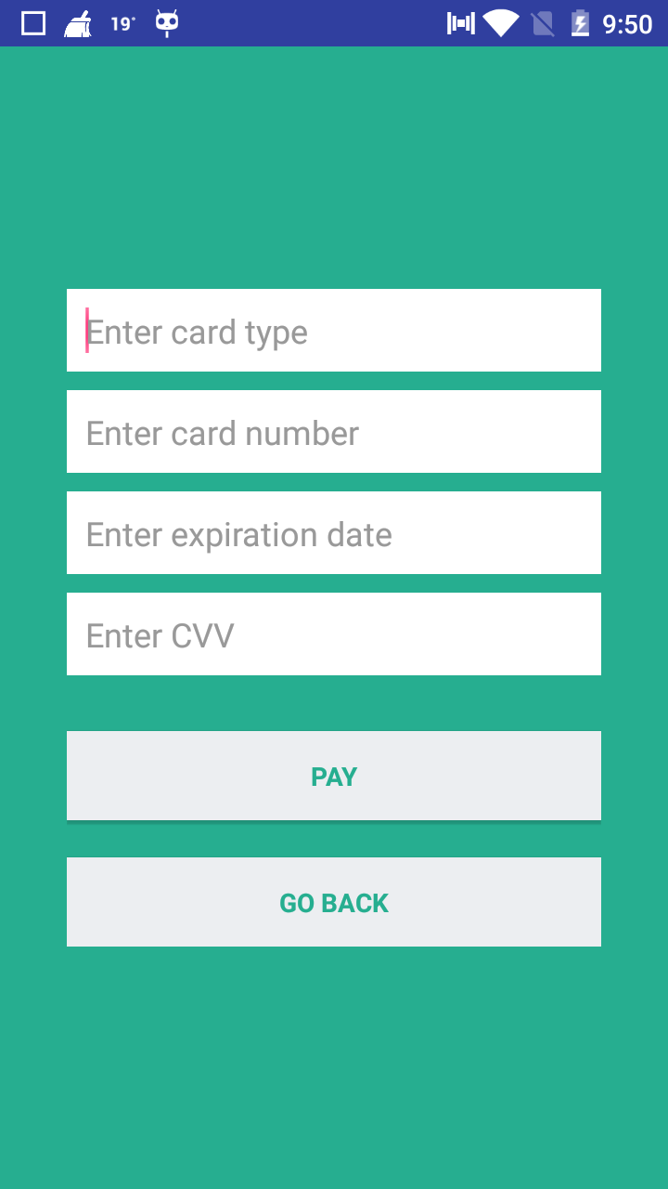
Payment Information Page
Implementation of Payment Information Page:
After selecting the products, the user navigates to the Payment Information page where the user enters the following details – Card Type, Card Number, Expiration Date, CVV.
The Identifier(“Message”),details, Session_CtoM and the TimeStamp are sent first to the merchant server.
After the merchant verifies the above mentioned details it replaces the session_CtoM with Session_MtoB(newly generated) and the old timestamp.
Session_MtoB is updated in the “Sessions” table.
The details are forwarded to the bank server.
The bank server verifies the timestamp and card details. If everything is correct, It sends the OTP to the client. It updates the same in the “OTP” table.
Else it sends a failure message to the client.
The client is directed to the OTP page.

Slide 23
Flow 3 : Merchant Server → Payment Gateway Server
Server gets Order Info encrypted. (confidentiality)
Server gets the hashed PI.
The plaintext OI is hashed and concatenated with hashed PI.
DS for the hashed concatenated info.
This DS is matched with the DS obtained from client and verified.
Server forwards the message to payment gateway.
Message = (encrypted{merchant's public key} order info)+(encrypted{bank's public key} payment info)+(hash of order info)+(hash of payment info)+(concatenated hash)

Slide 24
5) Client - Payment Gateway Exchange
Client
Bank
E(K_{b}⁺ , [Identifier, TimeStamp, OTP and Phone Number])
[OTP or failure message]

Slide 25
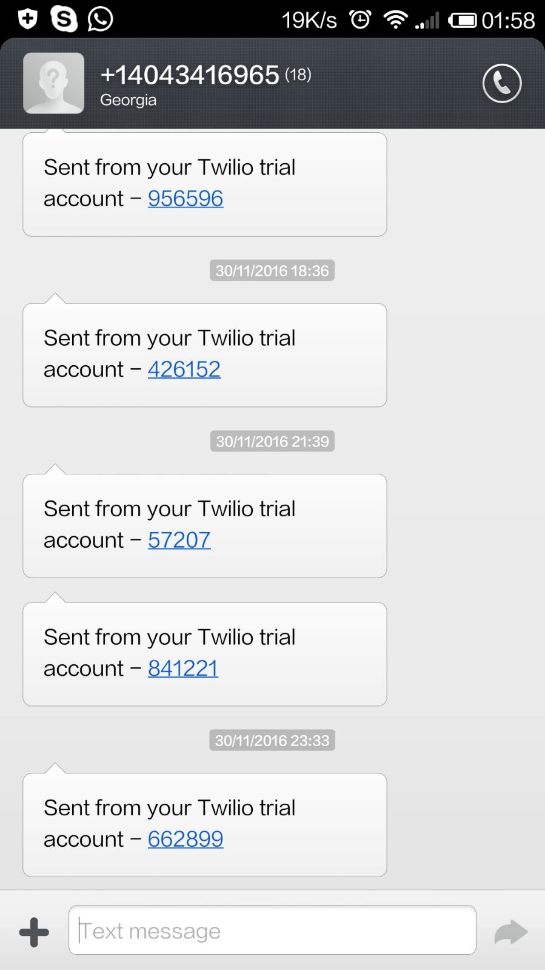
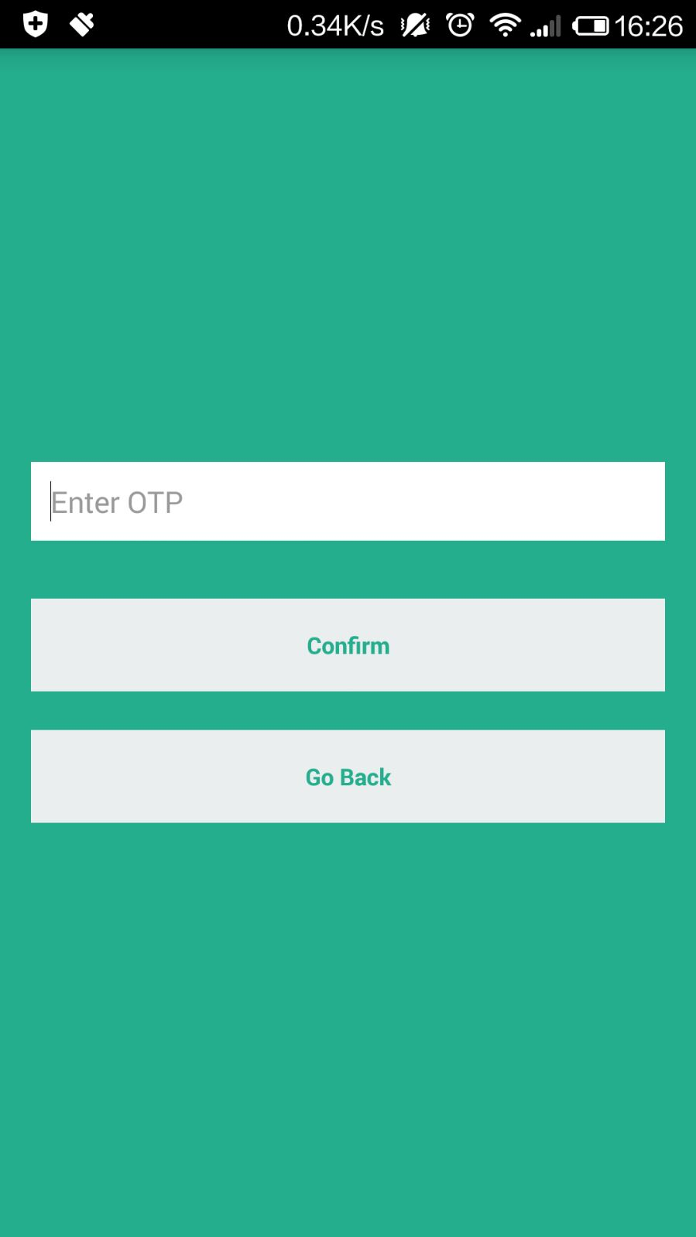
OTP Page
After entering the payment details the user confirms it and navigates to the OTP page. On this page the user enters the OTP received on his/her phone number.
The OTP is sent along with the Identifier(“OTP”), TimeStamp and Phone Number.
The bank server receives the OTP and checks it in the database table “OTP”.
Accordingly it sends a message to the merchant.

Slide 26
6) Bank Merchant Exchange
Bank
Merchant
E(K_{b}⁺ , [Identifier, TimeStamp, Session_MtoB and the message])

Slide 27
Flow 4 : Payment Gateway Server → Merchant Server
PG verifies it and then sends payment verification message to merchant.

Slide 28
7) Merchant Client Exchange
Merchant
Client
Email Notification

Slide 29
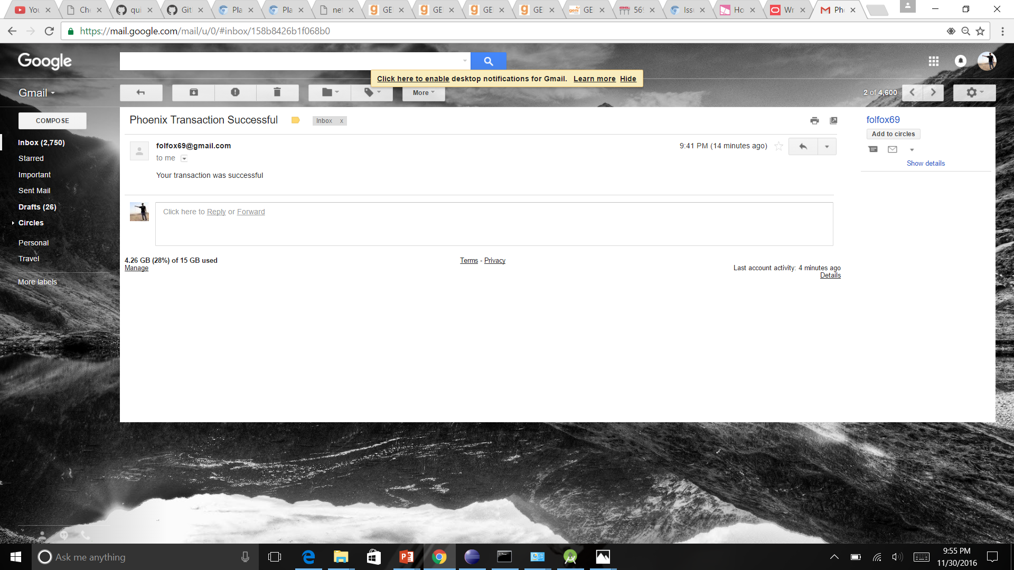
9) Success Email Notification
An email notification notifying that the transaction was successful is sent to the user’s registered email address.

Slide 30
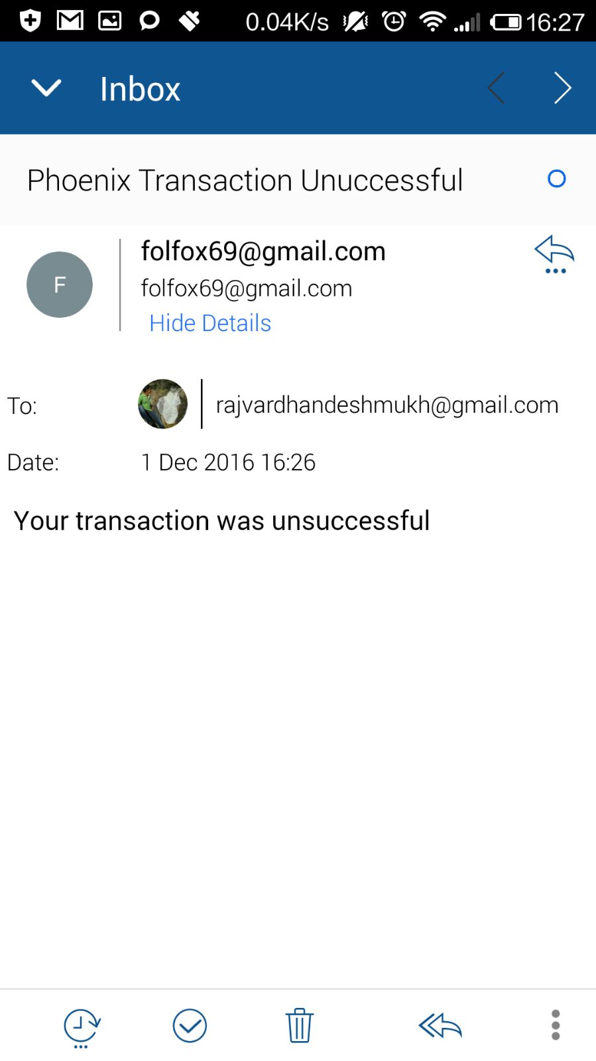
Failure Email Notification
A failure email notification notifying that the transaction failed is sent to the user’s registered email address.

Slide 31
Flow 5 : Merchant Server → Client
Merchant Server notifies client that the process is completed.

Slide 32

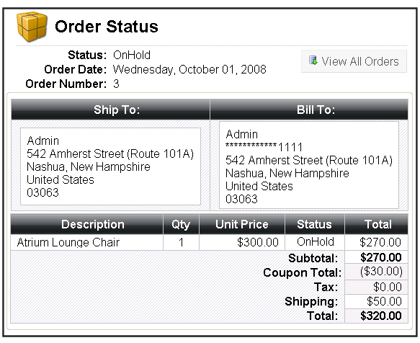

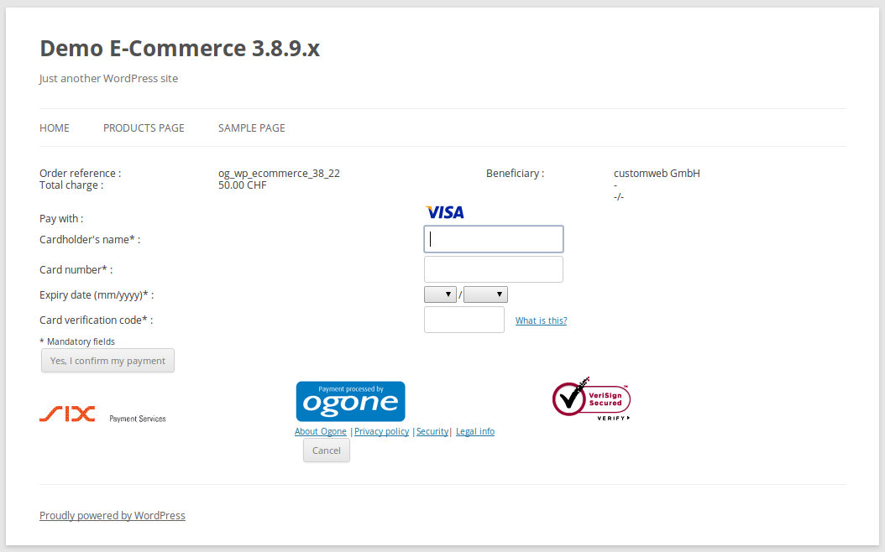

High Level Implementation Details
Hashed Order Info is sent
Hashed OI and Hashed PI is concatenated and hashed again and Dual Signature is provided
User orders using Android App
Order Information
Merchant Server
Hashed Payment Info is sent.
Encrypted OI and Hashed PI is sent
Payment Gateway
Payment Information

Slide 33
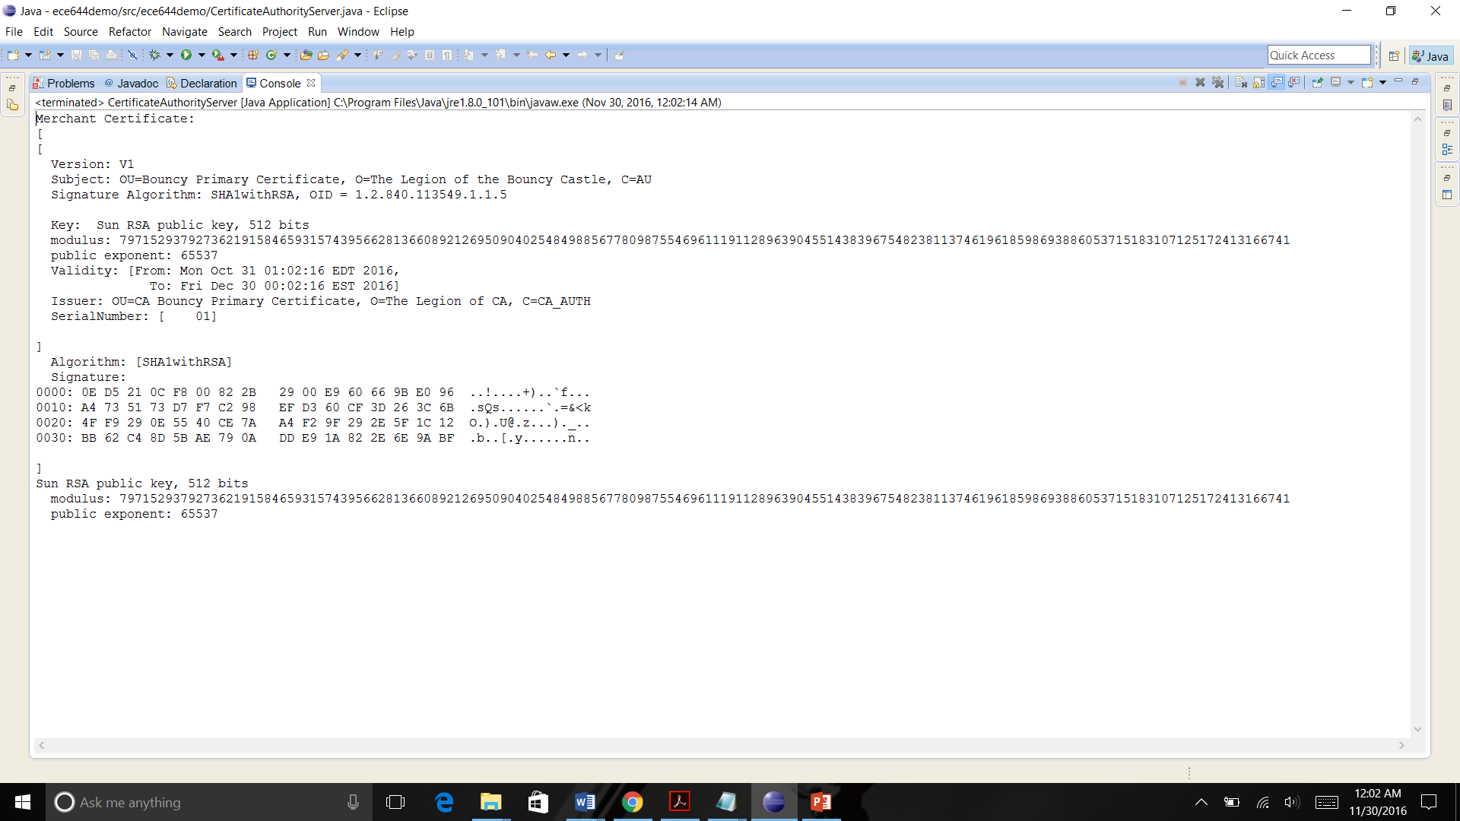
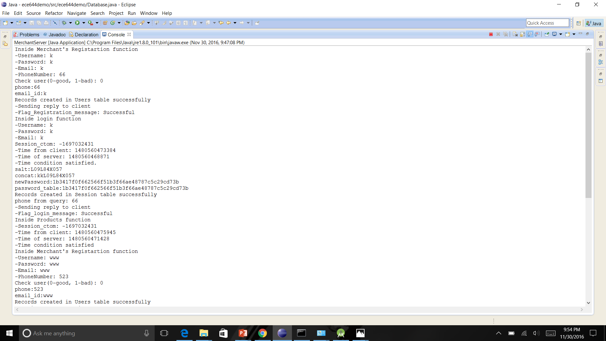
Java Console Screenshots
Certification Authority
Merchant Server

Slide 34
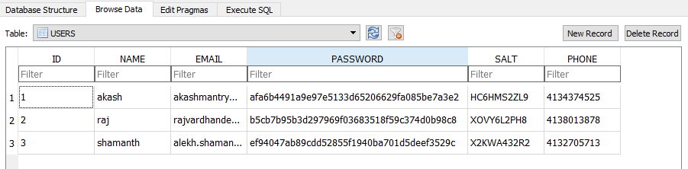
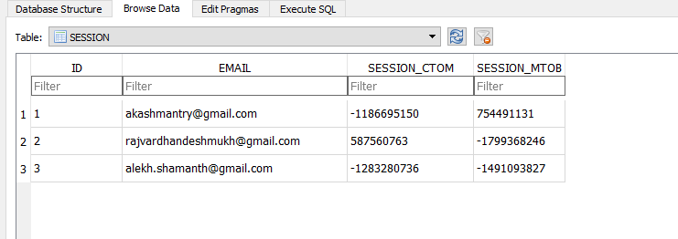
Database

Slide 35
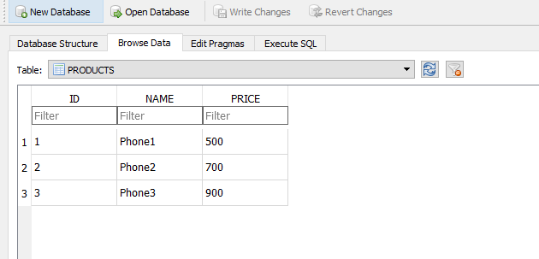
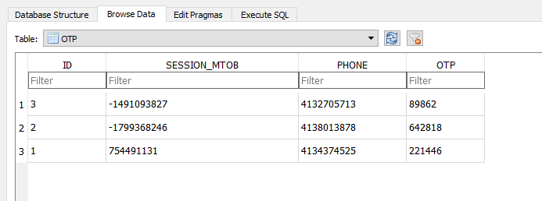

Slide 36
Steps followed to execute the implementation
Run the KeyGenerator Java Code
Run the CertificateAuthority Java Code
Run the Database Java Code
Run the Merchant Server
Register the New User
Open the App
Open Android Studio and run the App code
Run the Bank Server
Login with the new user
Select Products in the Products page
Enter Payment details in the Payment Page
Enter OTP received on phone and submit

Slide 37
Testing of the implementation(Attacks)
Replay Attack : The attacker captures the packet and replays it to get illegal services. The use of timestamp prevents this attack.
Masquerade Attack : Attacker masquerades as merchant when the merchant server is down. Since the data is encrypted the attacker cannot obtain meaningful data.
Man in the middle attack: When the merchant sends product list to the client the attacker captures this and modifies the product list and sends it to the client. This attack is prevented by using hash of the session key and the product list.

Slide 38
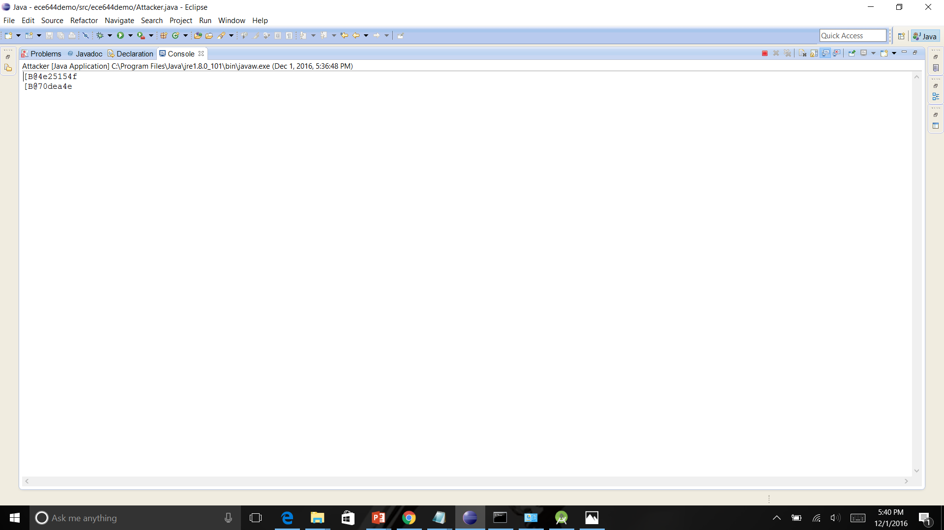
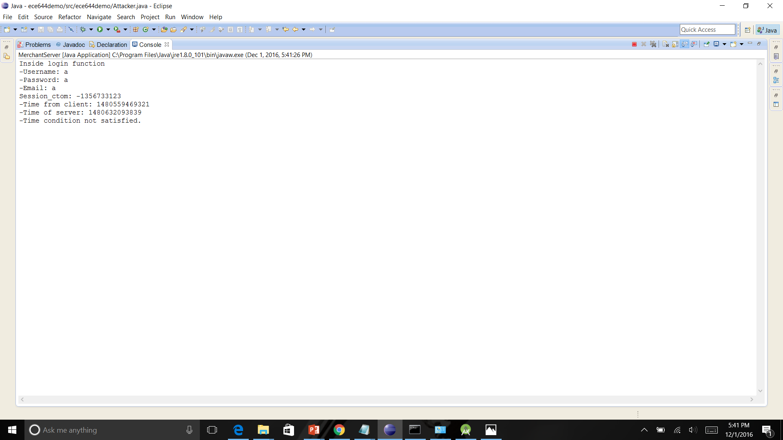
Attack Screenshots
Masquerade Attack
Replay Attack

Slide 39
References
YANG Rui-xia, “Design of Secure Mobile Payment System Based on IBC”, 2015 10th International Conference on Broadband and Wireless Computing, Communication and Applications.
Yong Wang, Christen Hahn and Kruttika Sutrave, “Mobile Payment Security, Threats, and Challenges”,
Android Integrating PayPal using PHP, MySQL http://www.androidhive.info/2015/02/android-integrating-paypal-using-php-mysql-part-1/
S. Lu and S. A. Smolka, "Model checking the secure electronic transaction (SET) protocol," Modeling, Analysis and Simulation of Computer and Telecommunication Systems, 1999. Proceedings. 7th International Symposium on, College Park, MD, 1999, pp. 358-364
M. C. Ruiz, D. Cazorla, F. Cuartero and J. J. Pardo, "A formal specification and performance evaluation of the purchase phase in the SET protocol," Seventh International Symposium on Symbolic and Numeric Algorithms for Scientific Computing

